Slide 1

Data Science Project
BY: Lae’sha Reed

Slide 2
Project Scope
Healthcare-Dataset-Stroke-Data
aims to address the critical issue of strokes, which are a leading cause of disability and death worldwide.
to analyze and better understand the factors that contribute to stroke occurrences, including age, gender, lifestyle, and medical history.

Slide 3

Benefits of Analysis
Improved understanding of stroke risk factors:
identify the factors that contribute to stroke occurrences, such as age, gender, lifestyle, and medical history.
develop more effective prevention and treatment strategies.
Early detection and prevention:
early detection and prevention efforts, such as lifestyle modifications, medication, or other medical interventions, can reduce the risk of a stroke occurring.
Development of new treatment methods:
development of new diagnostic and treatment methods for stroke patients.
more effective and personalized treatments, leading to improved patient outcomes.
Cost savings:
healthcare professionals can reduce the incidence of strokes and the associated healthcare costs.

Slide 4
Methodology.
Resources:
Kaggle Healthcare-stroke data set
Python and plotly
Challenges:
Categorical data is non-numerical data that represent groups or categories, such as gender, race, or occupation.
Visualizing categorical data requires a different approach than numerical data

Slide 5

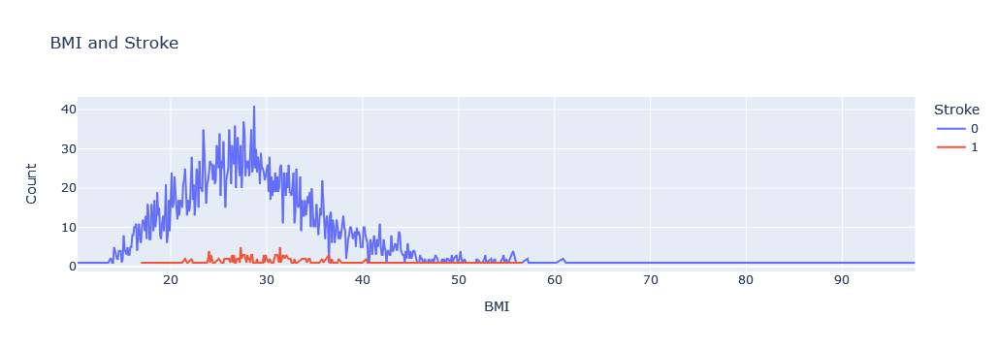
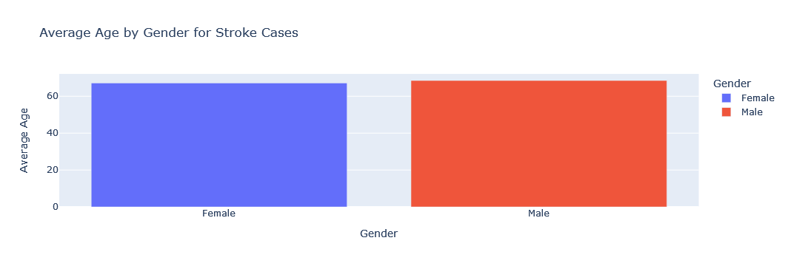

Slide 6
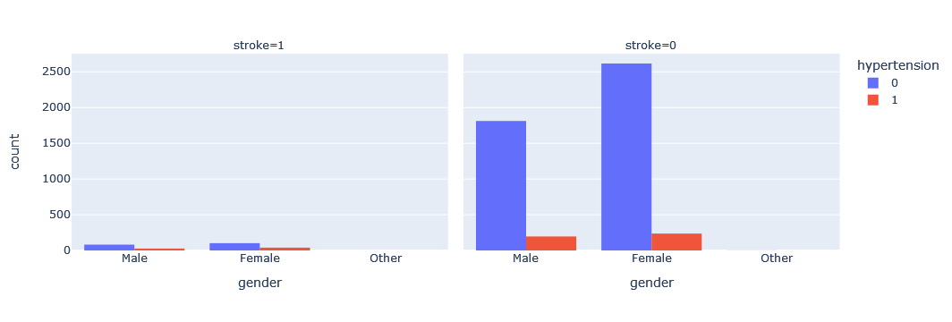
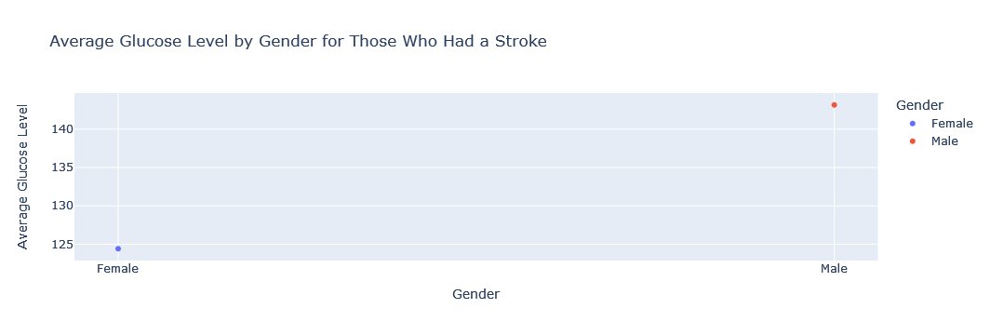
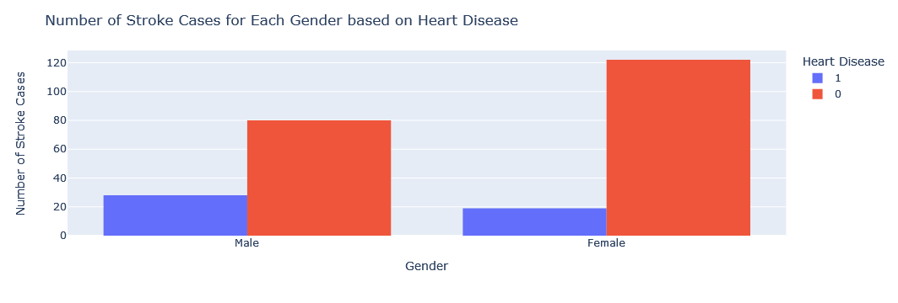

Slide 7

Machine Learning
Regression model to predict the probability of having a stroke based on several features
we can conclude that high average glucose levels are associated with an increased risk of having a stroke, but it needs more research

Slide 8
Recommendations
Doctors can educate their patients about the link between high glucose levels and strokes by explaining the mechanism through which high glucose levels increase the risk of stroke.
Provide information on lifestyle modifications such as a healthy diet, regular exercise, and weight management, that can help manage high glucose levels
Doctors can recommend routine blood glucose monitoring and periodic check-ups to keep track of glucose levels and assess the risk of stroke.
Patients can also be directed toward credible sources of information and support groups to help them manage their health.

